Slide 1
Module 6 Lecture
Healthcare for Vulnerable Populations and Data Analysis

Slide 2


Healthcare for Vulnerable Populations and Data Analysis
Our objectives for this lecture include:
Understand vulnerability and its effect on health
Develop skills of how to find credible, current healthcare data and analyze it critically

Slide 3

Health disparities
Underserved populations
Special populations
Health inequities
This Photo by Unknown Author is licensed under CC BY-SA-NC

Slide 4
Vulnerability
The convergence of risk factors at both individual and ecological levels and refers to the likelihood of experiencing poor health or illness.

Slide 5
More Vulnerability
Higher risk of poor health
Less Vulnerability
Lower risk of poor health

Slide 6
Population with Higher vulnerability
Ethnic minorities
Children
Women
Rural communities
Migrants
Homeless
Mentally illness
Substance abuse
Chronically ill and disabled
HIV/AIDS

Slide 7
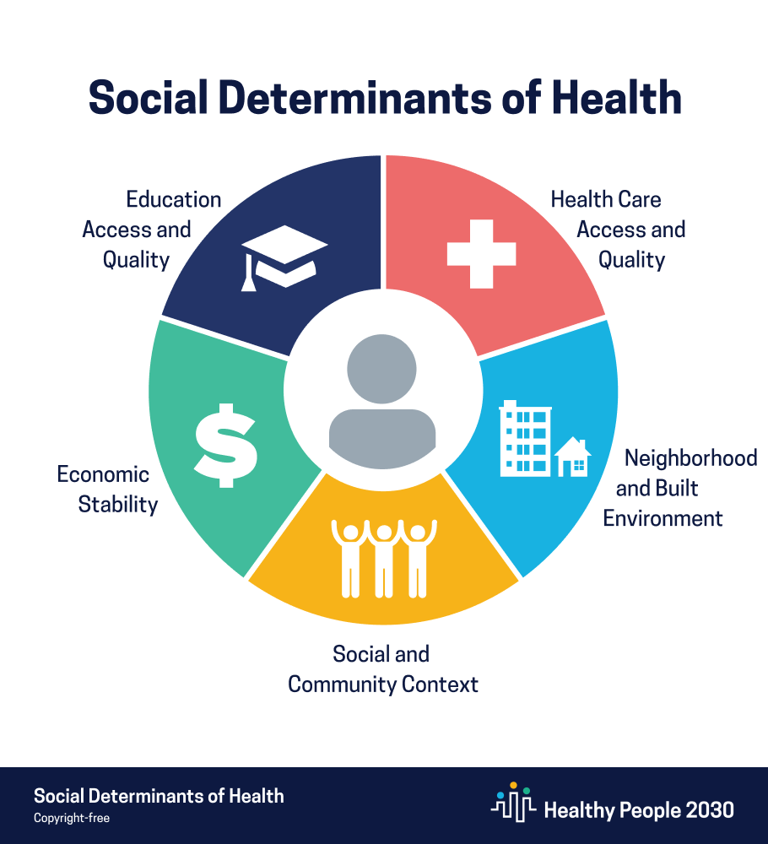
Social Determinants of health

Slide 8
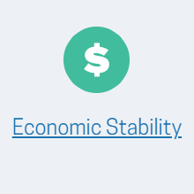
Poverty
Lack of resources
Time
Money

Slide 9

Increased education = better health
Lower college graduation rates in the ethnic minorities

Slide 10
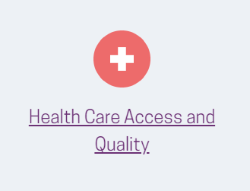
Rural communities lack services
Uninsured = low access to care

Slide 11
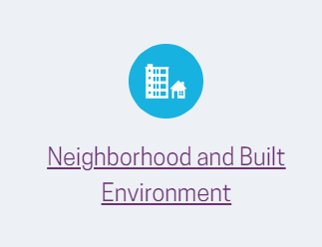
Violence
Unsafe air and water
Ethnic minorities and poverty

Slide 12
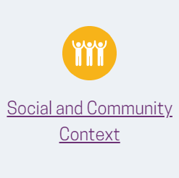
Relationships and acceptance in the community
Migrants, homeless, and those with mental illness

Slide 13
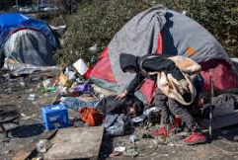

Slide 14
Summary and Up next
In summary we have discussed vulnerability and its impact on raising health risk through the lens of the SDOH.
The next point of discussion is how to find this data, understand it, and utilize it effectively. Please join me in the next video.

Slide 15
Data Analysis

Slide 16
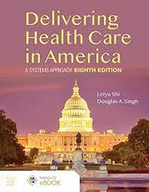
Textbook
Chapter 11
Introduction
Data trends
Old information

Slide 17
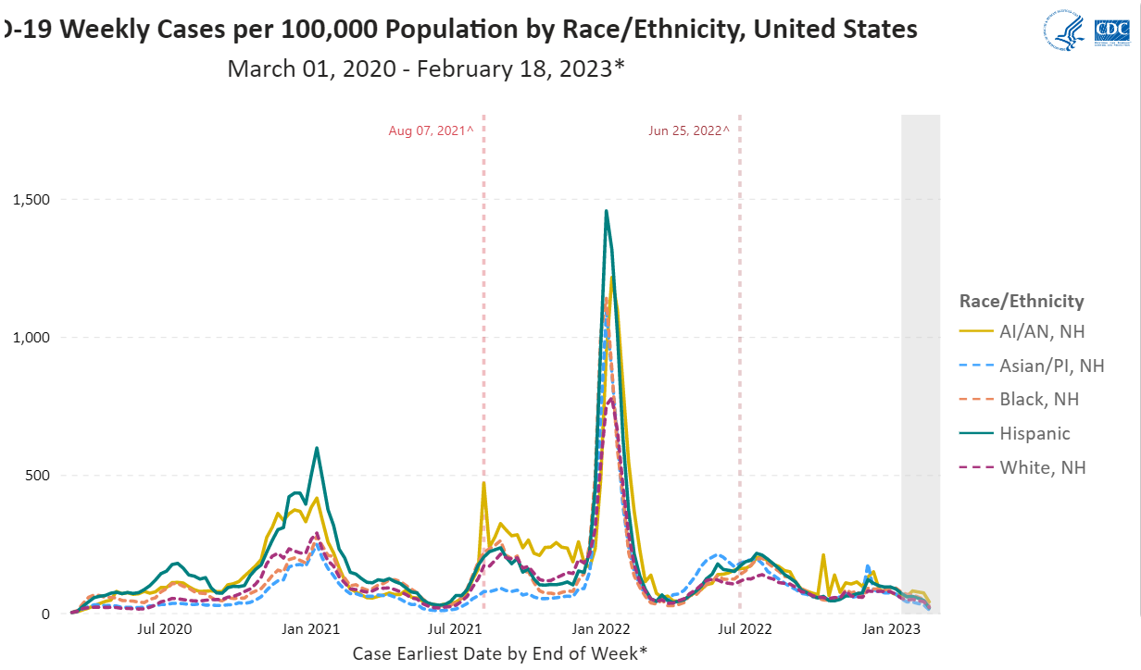

Slide 18
Credible Sources
Centers for Disease Control and Preventions (CDC)
Healthy People 2030
World Health Organization (WHO)
Professional Journals—AMA, Applied Nursing Research
Use statistician, informatists, and epidemiologists
Community Health Needs Assessment
Mandated by Affordable Care Act for non-profit hospital organizations
Every 3 years
Great source of community data
Reliable

Slide 19
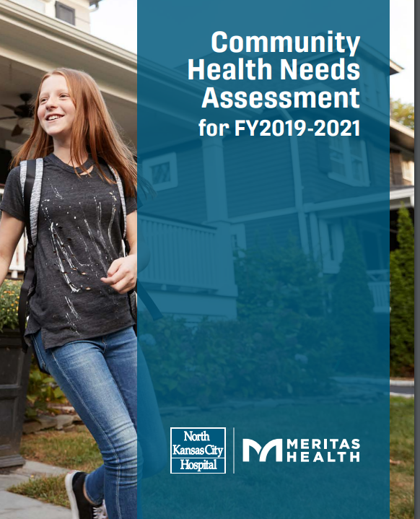
Community health Needs Assessment

Slide 20
SUMMARY
We have discussed how to find healthcare data and utilize it effectively.
#1 have the most current data
#2 get it from credible sources
#3 be curious about it…. What does it mean to me as a health administrator and what should I do with this new knowledge?

Slide 21
THANK YOU

